Slide 1
Code Based Testing
Path Testing

Slide 2
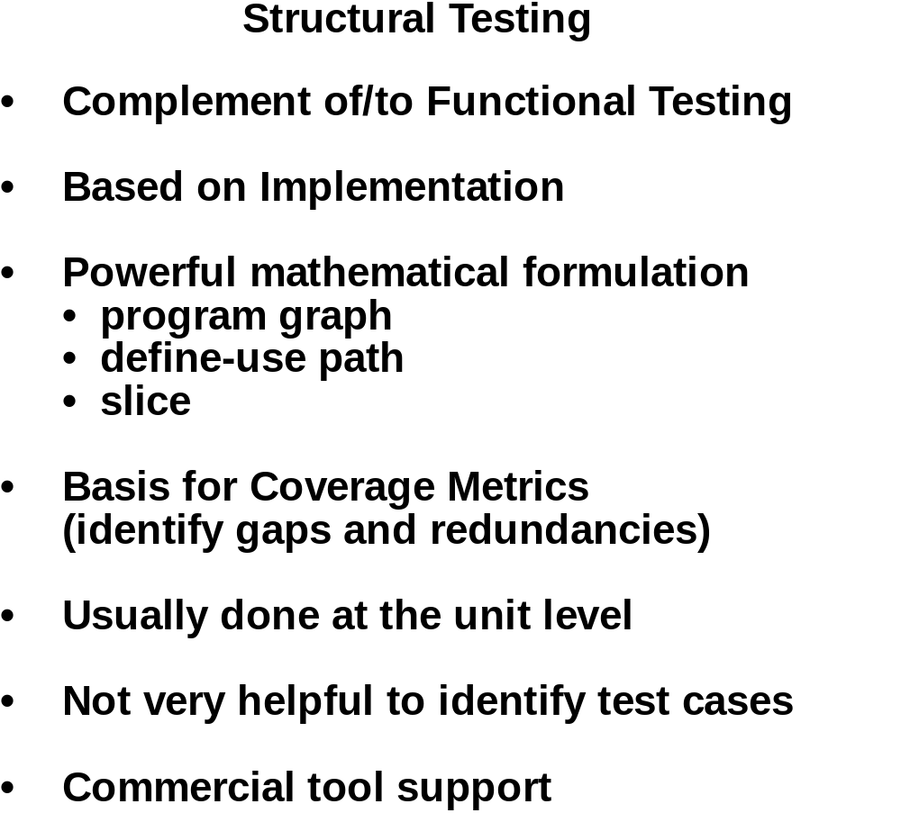

Slide 3
Code Based Testing
    Statement Testing
    Multiple Testing
    Loop
    Path
    Modified Path (MaCabe path)
    Data flow
    Transaction Flow
Statement
Cover at least once
    Assignment
    Input
    Output
    If-Then-Else (Predicate conditions)
    While Do
    Switch
    Function/Procedure Call Statement
A Variable declaration is not a statement
Since statement testing does not cover all statements, branch testing is used

Slide 4
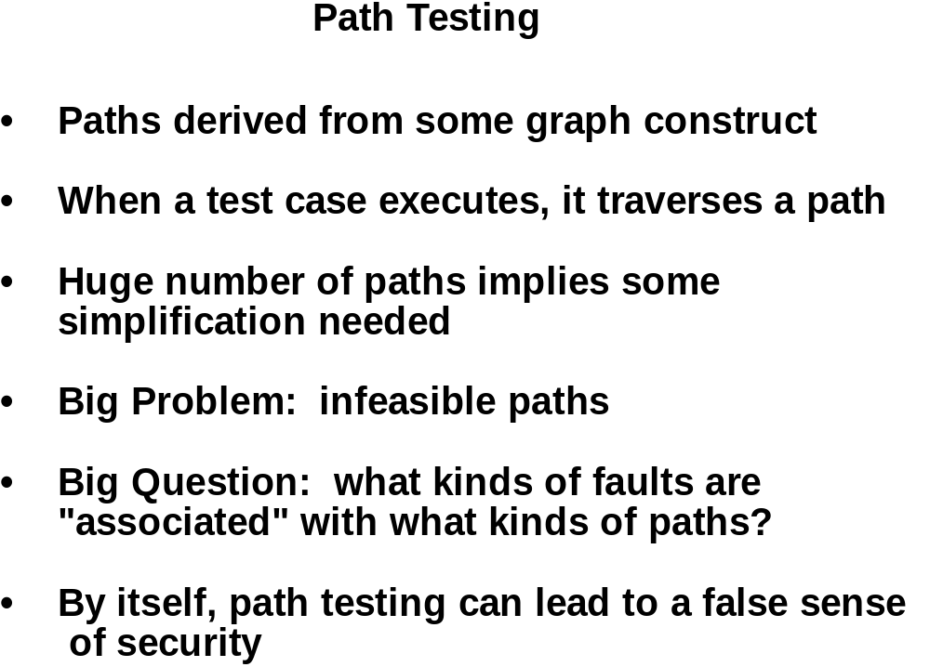

Slide 5
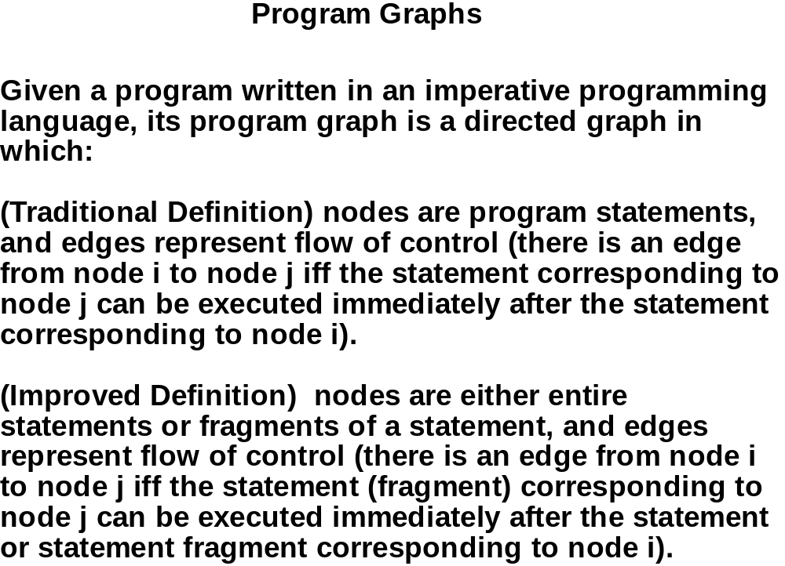

Slide 6
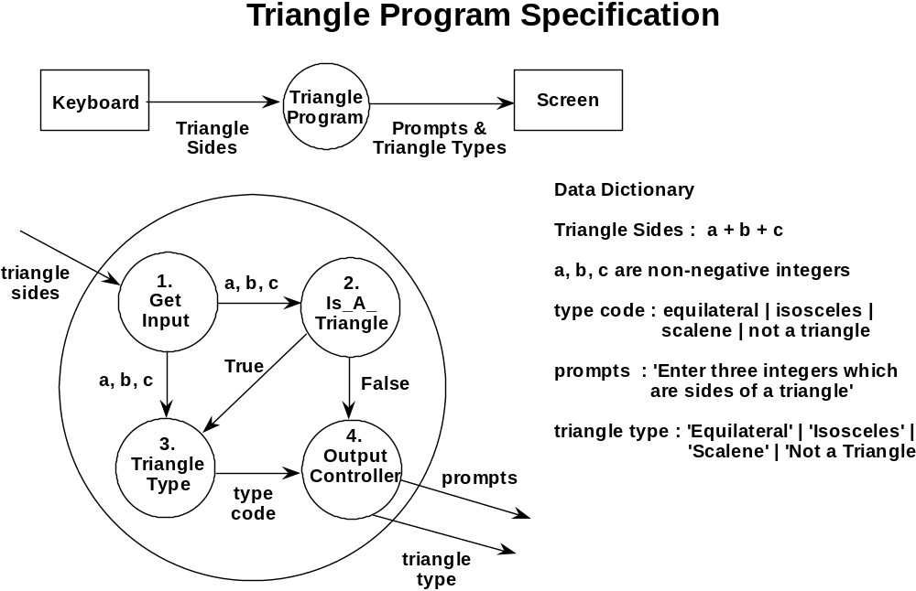

Slide 7
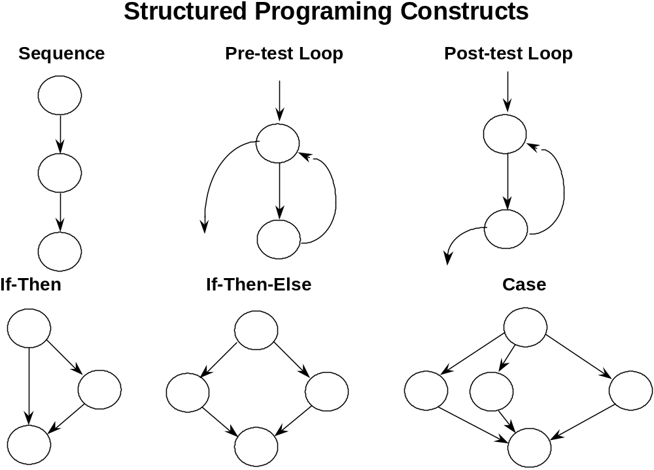

Slide 8
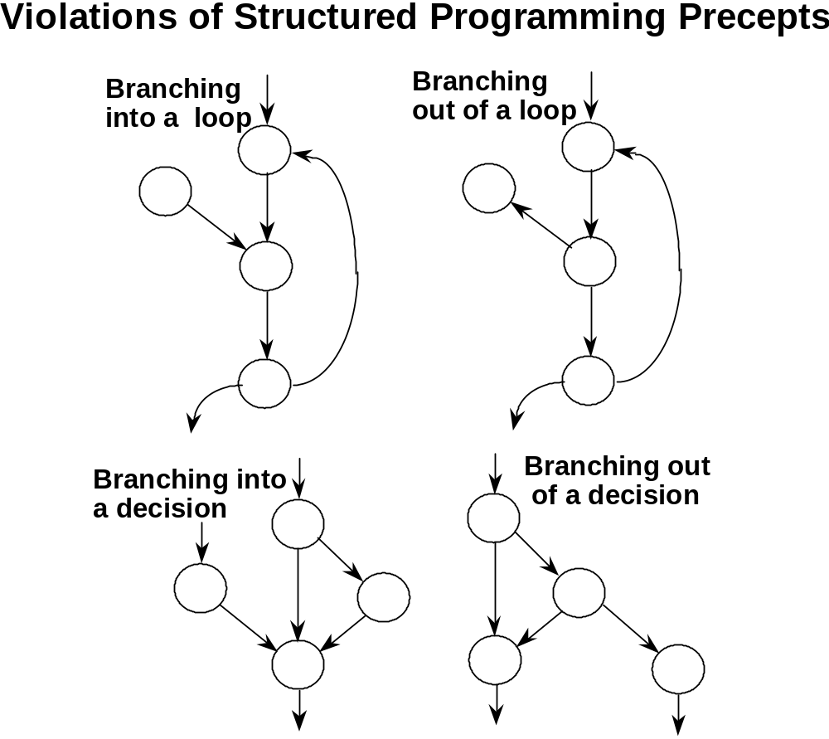

Slide 9
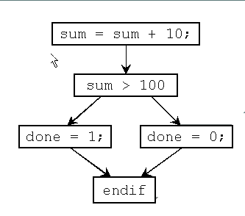
Simple example for CFG
Sum=Sum+10;
If (sum >100) Done=1;
Else
  Done=0;
Endif
1
2
3
4
5

Slide 10
CFG Example
B1
x = z – 2;
y = 2 * z;
if (c) {
x = x + 1;
y = y + 1;
}
else {
x = x – 1;
y = y – 1;
}
z = x + y
x = z – 2;
y = 2 * z;
if (c) B2 else B3
then
(fallthrough)
else
(taken)
B2
B3
x = x + 1;
y = y + 1;
goto B4
x = x – 1;
y = y – 1;
B4
z = z + y

Slide 11
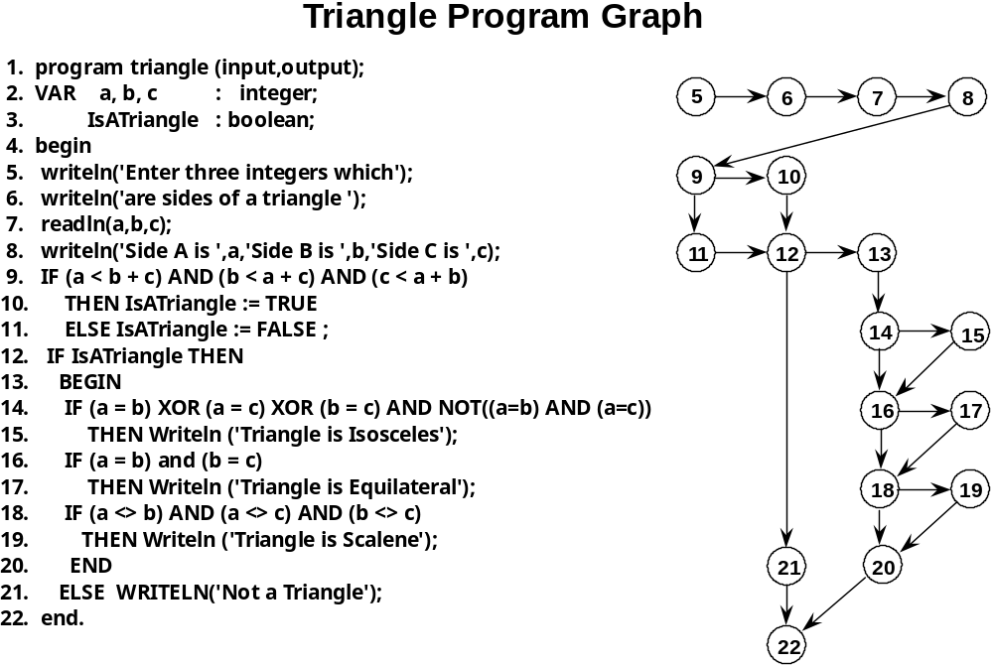
Sequence
If-then else
If-then else if
Acyclic graph 5 is source 22 is sink

Slide 12
Draw a Control flow graph
FindMean (FILE ScoreFile)
{ float SumOfScores = 0.0;
  int NumberOfScores = 0;
  float Mean=0.0; float Score;
  Read(ScoreFile, Score);
  while (! EOF(ScoreFile) {
    if (Score > 0.0 ) {
        SumOfScores = SumOfScores + Score;
        NumberOfScores++;
        }
    Read(ScoreFile, Score);
  }
  /* Compute the mean and print the result */
  if (NumberOfScores > 0) {
      Mean = SumOfScores / NumberOfScores;
      printf(“ The mean score is %f\n”, Mean);
  } else
      printf (“No scores found in file\n”);
}
1
2
3
4
5
6
7
8

Slide 13
Constructing the Logic Flow Diagram
Start
1
F
2
T
3
T
4
5
6
T
F
7
8
Exit

Slide 14
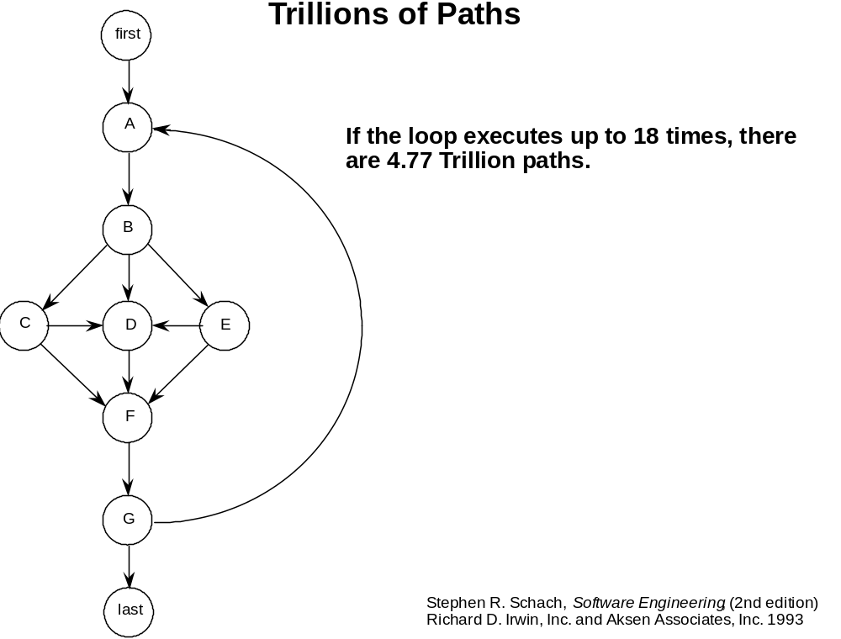
In this program, 5 paths lead from Node B to node F

Slide 15
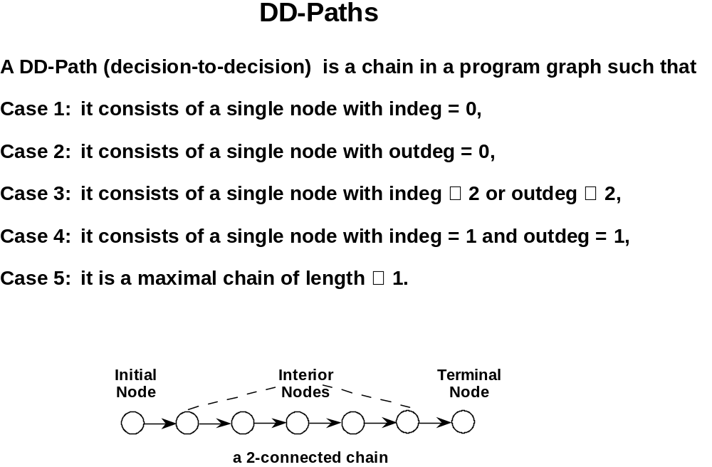
Works well for 2nd Generation language like FORTRAN

Slide 16
DD-Path Graph
Given a program written in an imperative language, its DD-Path graph is a labeled directed graph, in which nodes are DD-Paths pf its program graph, and edges represent control flow between successor DD-Paths.
In this respect, a DD-Path is a condensation graph. For example 2-connected program graph nodes are collapsed to a single DD-Path graph node.

Slide 17
4
8
9
Program Graph Nodes | DD-Path Name | Case #
4 | first | 1
5-8 | A | 5
9 | B | 4
10 | C | 4
11 | D | 3
12-14 | E | 5
15 | F | 4
16 | G | 3
17 | H | 4
18 | I | 3
19 | J | 4
20 | K | 3
21 | L | 4
22 | last | 2
5
10
11
12
13
6
14
15
7
21
16
17
18
19
first
22
20
A
A
B
C
E
D
F
G
L
H
I
J
K
last

Slide 18
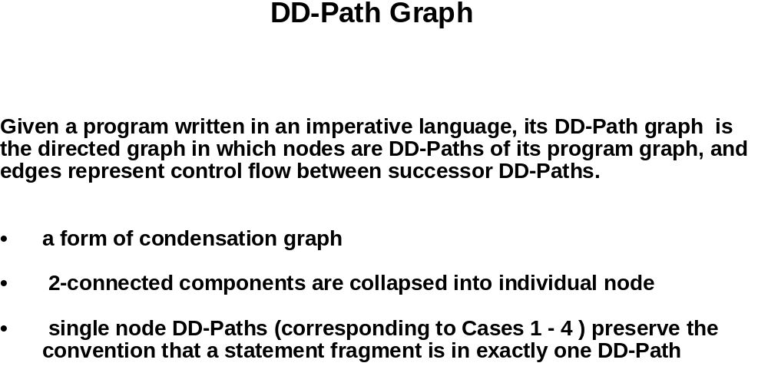

Slide 19
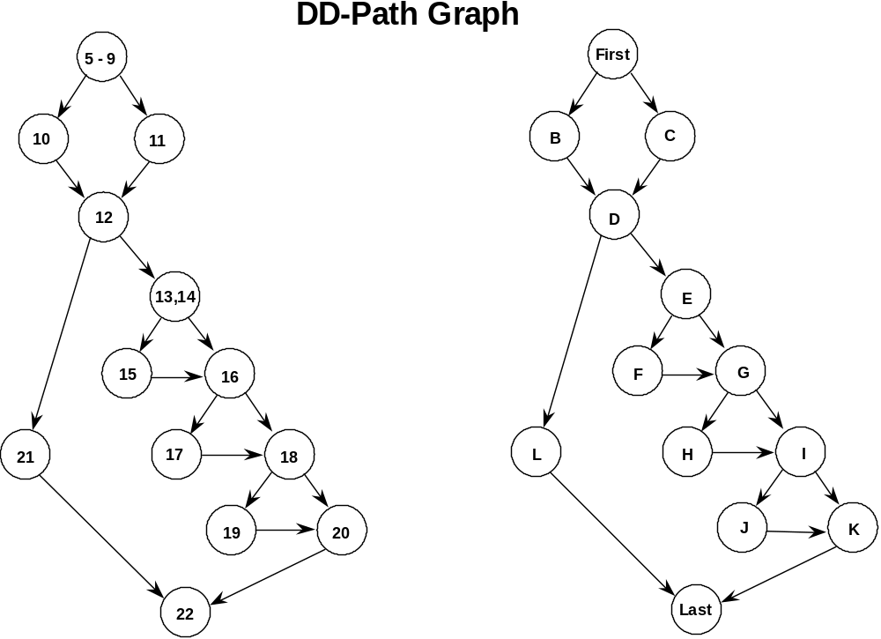

Slide 20
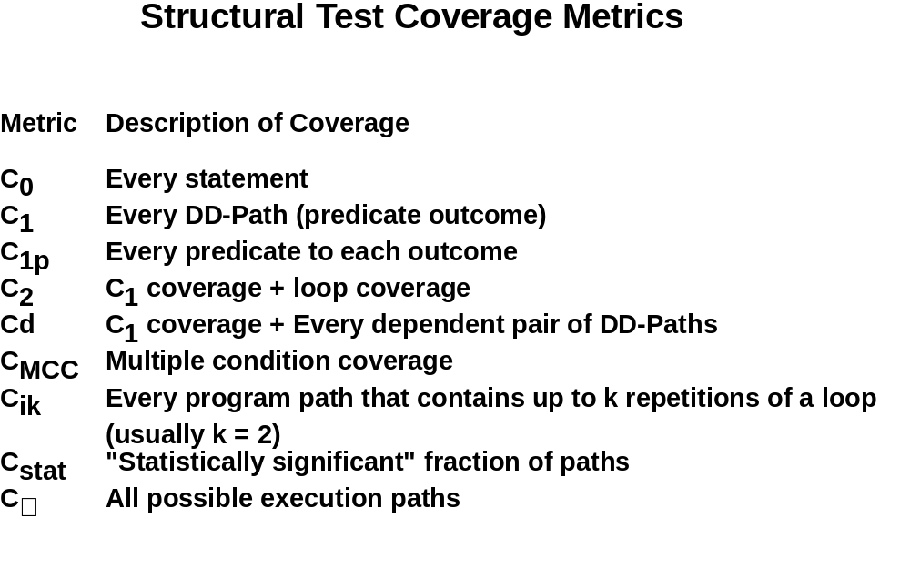

Slide 21
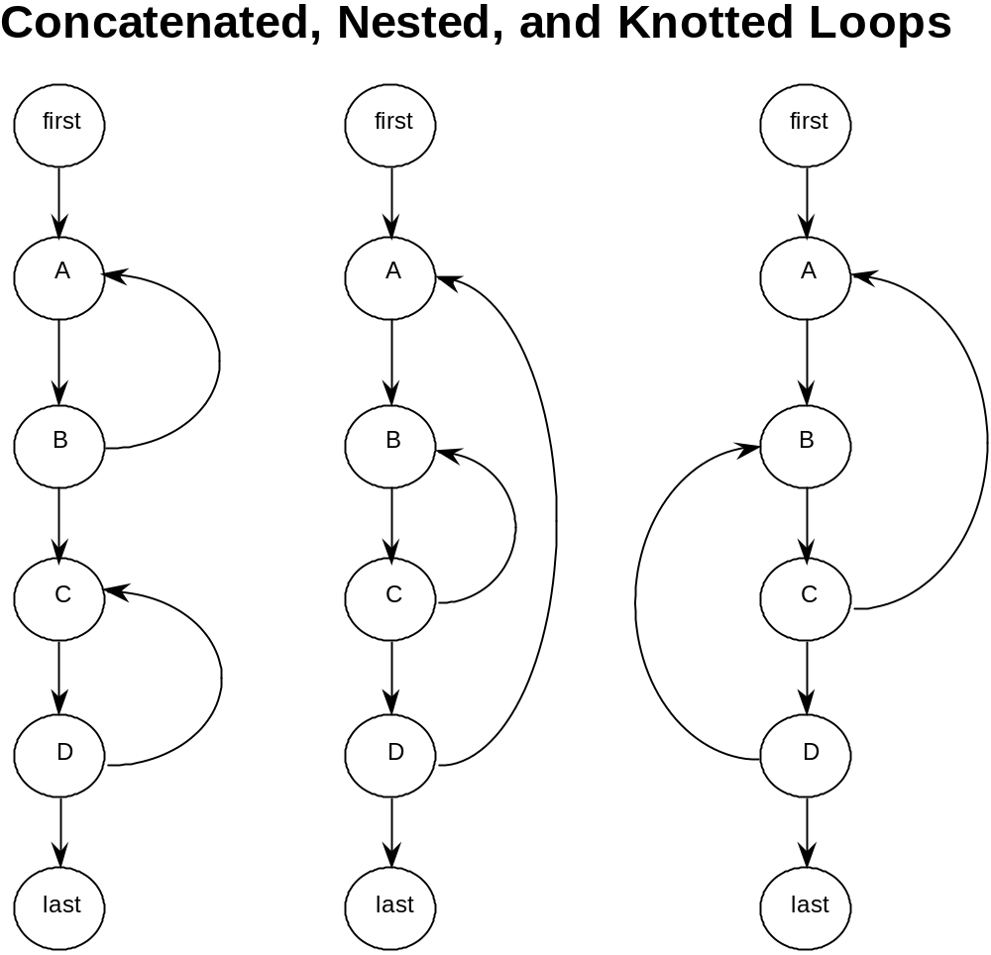
Testing Loops

Slide 22
Test Coverage Metrics
The motivation of using DD-paths is that they enable very precise descriptions of test coverage.
In our quest to identify gaps and redundancy in our test cases as these are used to exercise (test) different aspects of a program we use formal models of the program structure to reason about testing effectiveness.
Test coverage metrics are a device to measure the extend to which a set of test cases covers a program.

Slide 23
Test Coverage Metrics
Metric | Description of Coverage
C₀ | Every Statement
C₁ | Every DD-Path
C₁P | Every predicate to each outcome
C₂ | C₁ Coverage + loop coverage
C_{d} | C₁ Coverage + every dependent pair of DD-Paths
C_{MCC} | Multiple condition coverage
C_{i}k | Every program path that contains up to k repetitions of a loop (usually k=2)
C_{stat} | “Statistically significant” fraction of paths
C∞ | All possible execution paths

Slide 24
Statement and Predicate Coverage Testing
Statement coverage based testing aims to devise test cases that collectively exercise all statements in a program.
Predicate coverage (or branch coverage, or decision coverage) based testing aims to devise test cases that evaluate each simple predicate of the program to True and False. Here the term simple predicate refers to either a single predicate or a compound Boolean expression that is considered as a single unit that evaluates to True or False. This amounts to traversing every edge in the DD-Path graph.
For example in predicate coverage for the condition
if(A or B) then C we could consider the test cases A=True, B= False (true case), and A=False, B=False (false case). Note if the program was encoded as if(A) then C we would not detect any problem.

Slide 25
Statement coverage
Execute (exercise) every statement of a program
  Generate a set of test cases such that each statement of the program is executed at least one
Weakest white-box criterion
Supported by many commercial and freeware tools (test coverage or code coverage tools)
  Standard Unix tool: tcov
  A listing indicates how often each statement was executed and the percentage of statements executed
Note: in case of unreachable statements, statement coverage is not possible

Slide 26
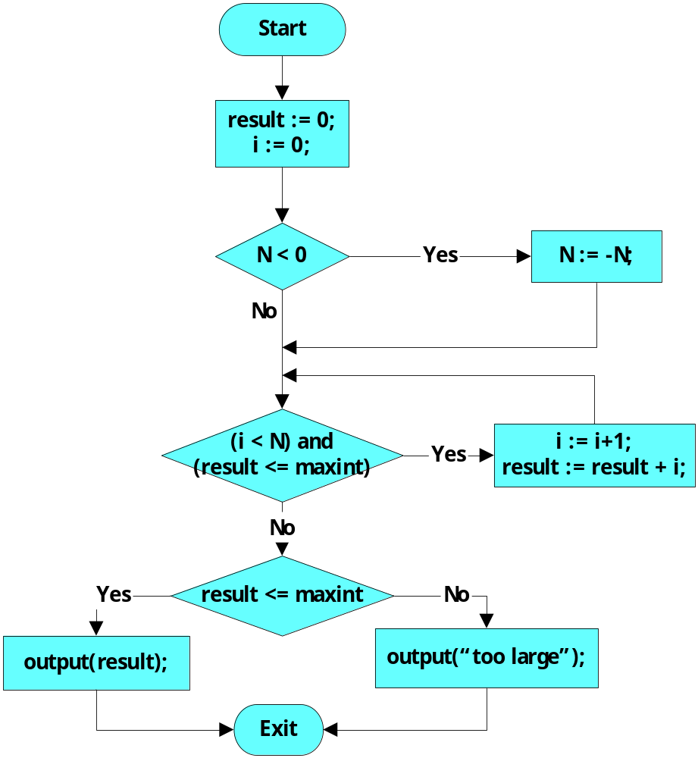
Example : statement coverage
Tests for complete
statement (node) coverage:
inputs |  | outputs
maxint | N | result
10 | -1 | 1
0 | -1 | too large

Slide 27
DD-Path Graph Edge Coverage C1
1
2
P1
T F
Here a T, T and F, F combination will
suffice to have DD-Path
Graph edge coverage or
Predicate coverage C1
P2
T F

Slide 28
DD-Path Coverage Testing C₁P
This is the same as the C₁ but now we must consider test cases that exercise all all possible outcomes of the choices T,T, T,F, F,T, F,F for the predicates P1, and P2 respectively, in the DD-Path graph.
P1
T F
P2
T F

Slide 29
Branch (or decision) coverage
Branch coverage == decision coverage
Execute every branch of a program :
each possible outcome of each decision occurs at least once
Example:
  simple decision: IF b THEN s1 ELSE s2
  multiple decision:
  CASE x OF
  1 : ….
  2 : ….
  3 : ….
Stronger than statement coverage
  IF THEN without ELSE – if the condition is always true all the statements are executed, but branch coverage is not achieved

Slide 30

Example : branch (or decision) coverage
Tests for complete
statement (node) coverage:
inputs |  | outputs
maxint | N | result
10 | -1 | 1
0 | -1 | too large
branch not tested
are not sufficient for
branch (edge) coverage!
Take:
inputs |  | outputs
maxint | N | result
10 | 3 | 6
0 | -1 | too large
for complete branch (edge) coverage

Slide 31
Condition coverage
Design test cases such that each possible outcome of each condition in a composite condition occurs at least once
Example:
  decision ( i < N ) AND (result <= maxint )
  consists of two conditions : ( i < N ) and (result <= maxint )
  test cases should be designed such that each gets value
  true and false at least once
Last test cases of previous slides already guarantee condition (and branch) coverage

Slide 32
Example : Branch and condition (or condition / decision) coverage
Test cases:
maxint N i result i<N result<=maxint
-1 1 0 0 true false
1 0 0 0 false true
give condition coverage
for all conditions
But don't preserve
branch coverage
⇓
always take care that
condition coverage
preserves branch coverage :
branch and condition coverage

Slide 33
Multiple Condition Coverage Testing
Now if we consider that the predicates P1 is a compound predicate (i.e. (A or B)) then Multiple Condition Coverage Testing requires that each possible combination of inputs be tested for each decision.
Example: “if (A or B)” requires 4 test cases:
A = True, B = True
A = True, B = False
A = False, B = True
A = False, B = False
The problem: For n conditions, 2^{n} test cases are needed, and this grows exponentially with n

Slide 34
Multiple condition coverage
Design test cases for each combination of conditions
Example:
  ( i < N ) (result <= maxint )
  false false
  false true
  true false
  true true
Implies branch-, condition-, branch and condition, modified branch/condition coverage
But : exponential blow-up (2^{number of conditions})
Again : some combinations may be infeasible

Slide 35
Independent path (or basis path) coverage
Obtain a maximal set of linearly independent paths (also called a basis of independent paths)
  If each path is represented as a vector with the number of times that each edge of the control flow graph is traversed, the paths are linearly independent if it is not possible to express one of them as a liner combination of the others
Generate a test case for each independent path
The number of linearly independent paths is given by the McCabe's cyclomatic complexity of the program
  Number of edges - Number of nodes + 2 in the control flow graph
  Measures the structural complexity of the program
Problem: some paths may be impossible to execute
Also called structured testing (see McCabe for details)
McCabe's argument: this approach produces a number of test cases that is proportional to the complexity of the program (as measured by the cyclomatic complexity), which, in turn, is related to the number of defects expected
More information:
  http://www.mccabe.com/iq_research_metrics.htm
  "Structured Testing: A Testing Methodology Using the Cyclomatic Complexity Metric", Arthur H. Watson, Thomas J. McCabe, NIST Special Publication 500-235

Slide 36
Example: Independent path coverage
1
2
3
4
number of (linearly) independent paths
= cyclomatic complexity
= number of edges - number of nodes + 2
= 12 – 10 + 2
= 4
Test cases
Path | inputs |  | outputs
 | maxint | N | result
1 | 1 | 0 | 0
2 | -1 | 0 | too large
3 | -1 | -1 | too large
4 | 10 | 1 | 1

Slide 37
Dependent DD-Path Pairs Coverage Testing C_{d}
In simple C₁ coverage criterion we are interested simply to traverse all edges in the DD-Path graph.
If we enhance this coverage criterion by ensuring that we also traverse dependent pairs of DD-Paths also we may have the chance of revealing more errors that are based on data flow dependencies.
More specifically, two DD-Paths are said to be dependent iff there is a define/reference relationship between these DD-Paths, in which a variable is defined (receives a value) in one DD-Path and is referenced in the other.
In C_{d} testing we are interested on covering all edges of the DD-Path graph and all dependent DD-Path pairs.

Slide 38
Loop Coverage
The simple view of loop testing coverage is that we must devise test cases that exercise the two possible outcomes of the decision of a loop condition that is one to traverse the loop and the other to exit (or not enter) the loop.
An extension would be to consider a modified boundary value analysis approach where the loop index is given a minimum, minimum +, a nominal, a maximum -, and a maximum value or even robustness testing.
Once a loop is tested, then the tester can collapse it into a single node to simplify the graph for the next loop tests. In the case of nested loops we start with the inner most loop and we proceed outwards.
If loops are knotted then we must apply data flow analysis testing techniques.

Slide 39
Statistically Significant Path Coverage Testing
Exhaustive testing of software is not practical because variable input values and variable sequencing of inputs result in too many possible combinations to test.
NIST developed techniques for applying statistical methods to derive sample test cases would address how to select the best sample of test cases and would provide a statistical level of confidence or probability that a program implements its functional specification correctly.
The goal of statistically significant coverage is to develop methods for software testing based on statistical methods, such as Multivariable Testing, Design of Experiments, and Markov Chain usage models, and to develop methods for software testing based on statistical measures and confidence levels.
Source: http://www.itl.nist.gov/div897/ctg/stat/mar98ir.pdf

Slide 40
Basis Path Testing
We can apply McCabe’s Cyclomatic Complexity metric
  gives an upper bound on number of test cases to ensure edge coverage is satisfied.
  in practice, it is usually the “lower bound” of the number of test cases due to the presence of loops.

Slide 41
Basis Path Testing - Motivation
If we consider the paths in a program graph (or DD-Graph) to form a vector space V, we are interested to devise a subset of V say B that captures the essence of V; that is every element of V can be represented as a linear combination of elements of B. Addition of paths means that one path is followed by another and multiplication of a number by a path denotes the repetition of a path.
If such a vector space B contains linearly independent paths and forms a “basis” for V then it certainly captures the essence of V.

Slide 42
McCabe Algorithm to Determine Basis Paths
The algorithm is straightforward:
  The method begins with the selection of a “baseline path”, which should correspond to a normal execution of a program (from start node to end node, and has as many decisions as possible).
  The algorithm proceeds by retracing the paths visited and flipping the conditions one at a time.
  The process repeats up to the point all flips have been considered.
The objective is to generate test cases that exercise these “basis” paths.

Slide 43
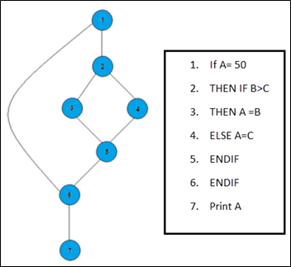
The objective behind basis path in software testing is that it defines the number of independent paths, thus the number of test cases needed can be defined explicitly (maximizes the coverage of each test case).
In the above example, we can see there are few conditional statements that is executed depending on what condition it suffice. Here there are 3 paths or condition that need to be tested to get the output,
Path 1: 1,2,3,5,6, 7
Path 2: 1,2,4,5,6, 7
Path 3: 1, 6, 7

Slide 44
Steps for Basis Path testing
The basic steps involved in basis path testing include
  Draw a control graph (to determine different program paths)
  Calculate Cyclomatic complexity (metrics to determine the number of independent paths)
  Find a basis set of paths
  Generate test cases to exercise each path
Advantages of Basic Path Testing
  It helps to reduce the redundant tests
  It focuses attention on program logic
  It helps facilitates analytical versus arbitrary case design
  Test cases which exercise basis set will execute every statement in a program at least once

Slide 45
Flow Graphs – Use in determining
Paths for Testing - Revisited
V(
G) = 3
1
Basis set:
x = z+5
1, 2, 3, 4, 6, 7
z = 4*3
-
y
1, 2, 3, 4, 5, 4, 6, 7
1, 2, 6, 7
x > z
2
t
x = z+5
z = 4*3
-
y
f
6
if(x > z) goto A;
R1
R2
for( u=0; u < x; u++) {
z = z+1;
3
};
y = z+k
5
t
f
A: y = z + k
u = 0
z = z+1
u++
R3
7
4
u < x
Example of a simple control flowgraph.

Slide 46
Control flow analysis
Example 2
1 PROGRAM sum ( maxint, N : INT )
2 INT result := 0 ; i := 0 ;
3 IF N < 0
4 THEN N := - N ;
5 WHILE ( i < N ) AND ( result <= maxint )
6 DO i := i + 1 ;
7 result := result + i ;
8 OD;
9 IF result <= maxint
10 THEN OUTPUT ( result )
11 ELSE OUTPUT ( “too large” )
12 END.

Slide 47
Modified Condition/Decision Coverage
Also known as MC/DC or MCDC
Design test cases such that
  every decision in the program has taken all possible outcomes at least once (branch or decision coverage)
  every condition in a decision in the program has taken all possible outcomes at least once (condition coverage)
  every condition in a decision has been shown to independently affect that decision’s outcome (a condition is shown to independently affect a decision’s outcome by varying just that condition while holding fixed all other possible conditions)
    (condition – a Boolean expression containing no Boolean operators)
    (decision – a Boolean expression composed of conditions and zero or more Boolean operators)
Created at Boeing, is required for aviation software for the Federal Aviation Administration (FAA) in the USA by RCTA/DO-178B
Usually considered necessary for adequate testing of critical software

Slide 48
Modified Condition/Decision Coverage
Designed for languages with logical operators that do not short-circuit, such as Ada and Visual Basic .Net (Or/OrElse, And/AndAlso)
For languages with logical operators that short-circuit, as in C, C++, Java and C#, MC/DC requires exactly the same test cases as condition/decision coverage (?)
  the logical operators in these languages only evaluate conditions when their result can affect the encompassing decision
More information:
  RTCA/DO-178B, "Software Considerations in Airborne Systems and Equipment Certification", Radio Technical Commission for Aeronautics, USA, December 1992
  Chilenski1994 John Joseph Chilenski and Steven P. Miller, "Applicability of Modified Condition/Decision Coverage to Software Testing", Software Engineering Journal, September 1994, Vol. 9, No. 5, pp.193-200.
  A Practical Tutorial on Modified Condition / Decision Coverage, NASA / TM-2001-210876 (http://www.faa.gov/certification/aircraft/av-info/software/Research/MCDC%20Tutorial.pdf)

Slide 49
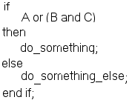
Example: Modified Condition/Decision Coverage
Consider the following fragment of code:
MC/DC may be achieved with the following set of test inputs (note that there are alternative sets of test inputs, which will also achieve MC/DC):
  Case A B C Outcome
  1 FALSE FALSE TRUE FALSE
  2 TRUE FALSE TRUE TRUE
  3 FALSE TRUE TRUE TRUE
  4 FALSE TRUE FALSE FALSE
Because:
  A is shown to independently affect the outcome of the decision condition by case 1 and case 2
  B is shown to independently affect the outcome of the decision condition by case 1 and case 3
  C is shown to independently affect the outcome of the decision condition by case 3 and case 4
are not evaluated if logical operators short-circuit
cases 2 a 4 are sufficient for branch and condition coverage, but only if logical operators do not short-circuit

Slide 50
Path coverage
Execute every possible path of a program,
i.e., every possible sequence of statements
Strongest white-box criterion (based on control flow analysis)
Usually impossible: infinitely many paths ( in case of loops )
So: not a realistic option
But note : enormous reduction w.r.t. all possible test cases
(each sequence of statements executed for only one value)
(doesn't mean exhaustive testing)

Slide 51
White-Box Testing : Overview
statement
coverage
weakest
condition
coverage
branch
(or decision)
coverage
branch and condition
(or condition /decision) coverage
modified condition / decision coverage
independent path (or basis path)
coverage
multiple- condition
coverage
only if paths across composite conditions are distinguished
strongest
path
coverage

Slide 52
Basic Idea
Test some paths of program graph:
  Efficiency: as few paths as possible
  Completeness: paths form a (mathematical) basis
    Not much overlap among paths
    As many paths as needed to cover complexity of branching in program graph
Intuition: all crucial behavior is tested
Formula
  CC=E-N+2 or CC=E-N+p Where
  CC = Cyclomatic Complexity
  E = the number of edges of the graph
  N = the number of nodes of the graph
  P = the number of connected components.

Slide 53
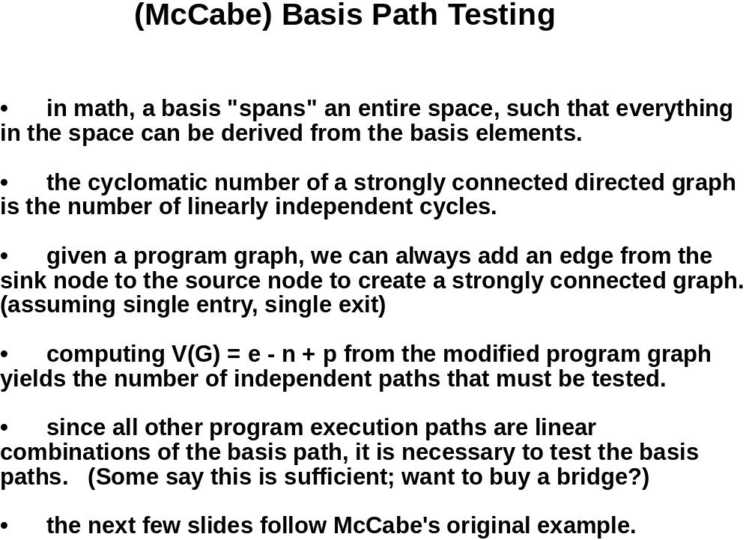

Slide 54
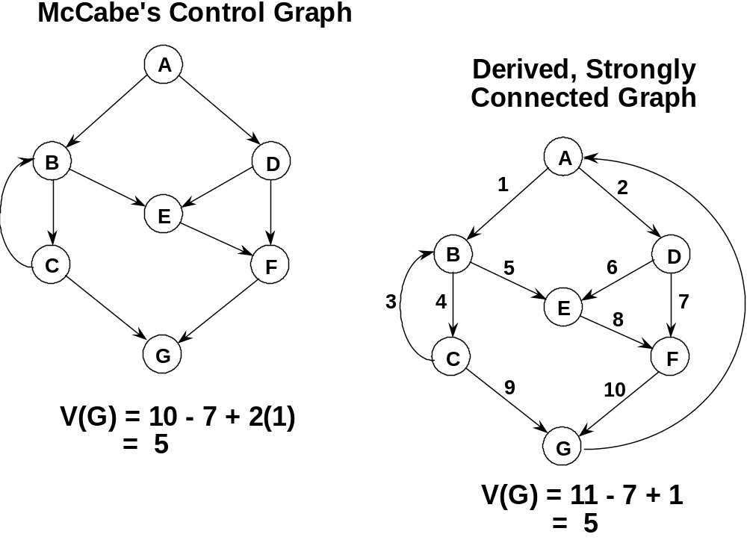

Slide 55
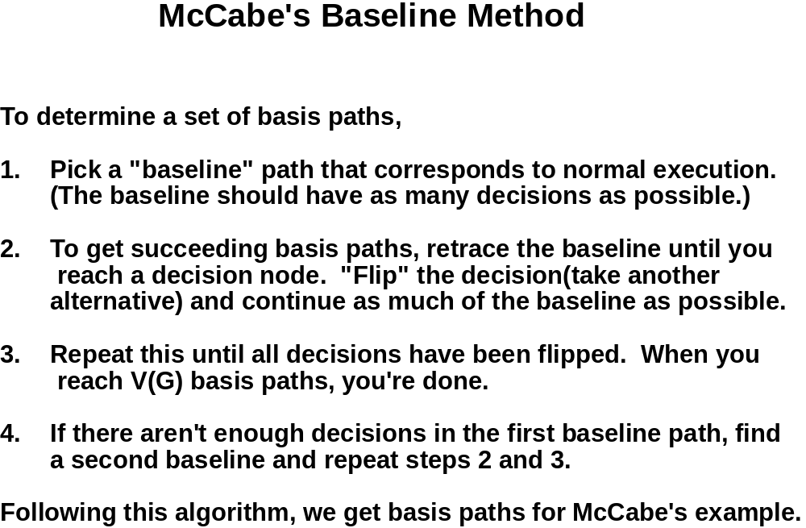

Slide 56
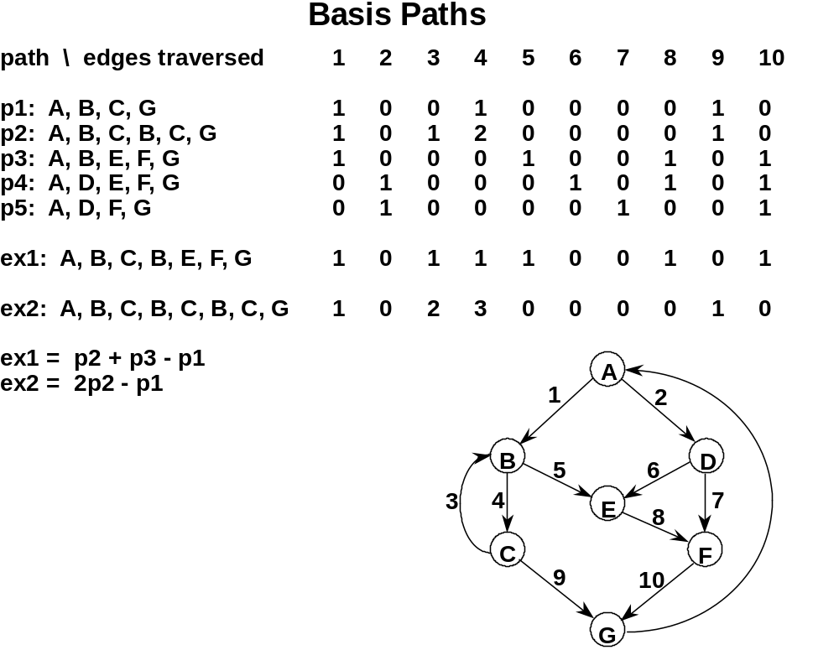

Slide 57
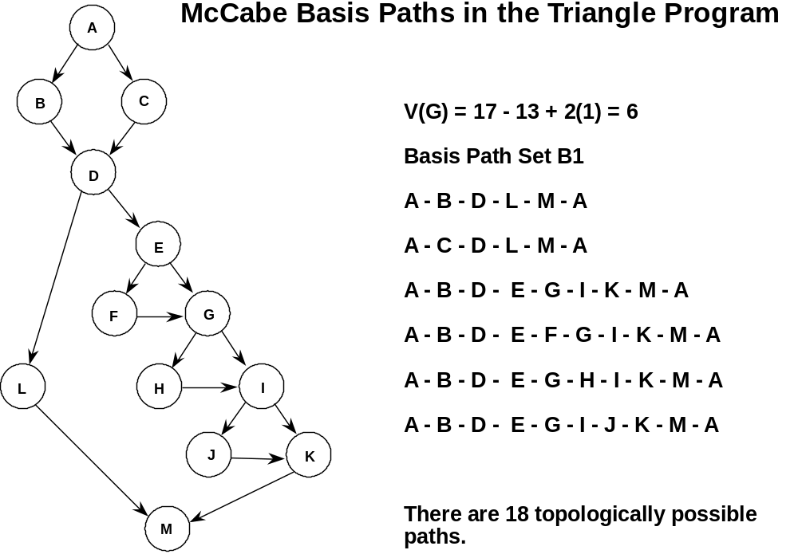

Slide 58
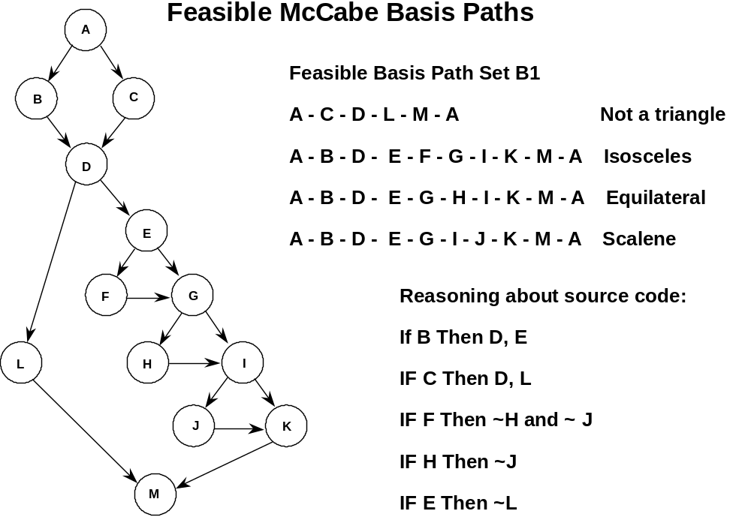

Slide 59
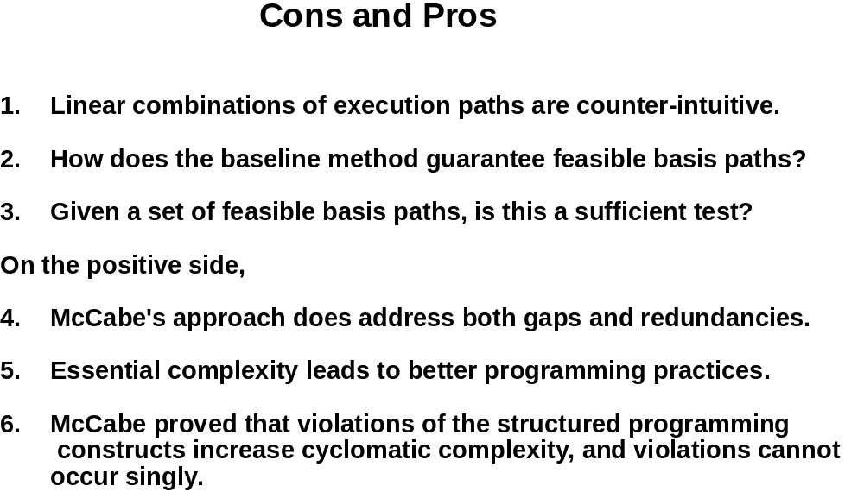

Slide 60
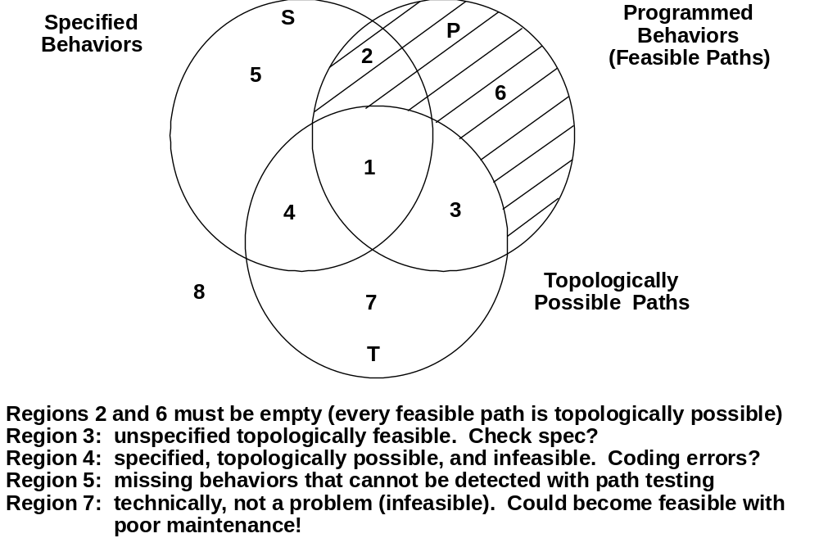

Slide 61

Questions?

